Slide 1
Breast Cancer Wisconsin (Diagnostic)
Whether the cancer is benign or malignant?

Slide 2
Breast Cancer Wisconsin (Diagnostic)
Identify the problem
Excluding skin cancer, breast cancer is the most common type of cancer in women in the United States, accounting for one of every three cancer diagnoses.
It ranks second among cancer deaths in women.
Breast Cancer occurs as a result of abnormal growth of cells in the breast tissue, commonly referred to as a Tumor. A tumor does not mean cancer - tumors can be benign (not cancerous), pre-malignant (pre-cancerous), or malignant (cancerous).
Objectives
The goal of this project is the application of several data mining and machine learning techniques to classify whether the tumor mass is benign or malignant in women residing in the state of Wisconsin, USA.

Slide 3
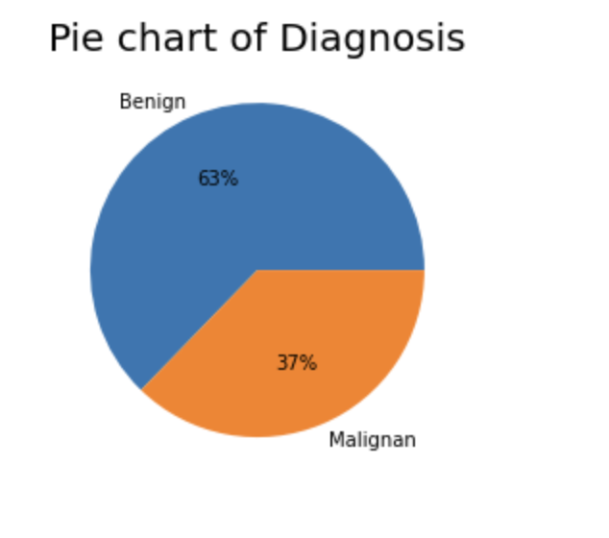
Exploratory Data Analysis
The dataset contains a class imbalance between the malignant (M) and benign (B).
357 observations which account for 63% of all observations indicating the absence of cancer cells,
212 which accounts for 37 % of all observations shows the presence of cancerous cell.
The percent is unusually large; the dataset does not represent in this case a typical medical analysis distribution. Typically, we will have a considerable large number of cases that represents negative vs. a small number of cases that represents positives (malignant) tumor.

Slide 4
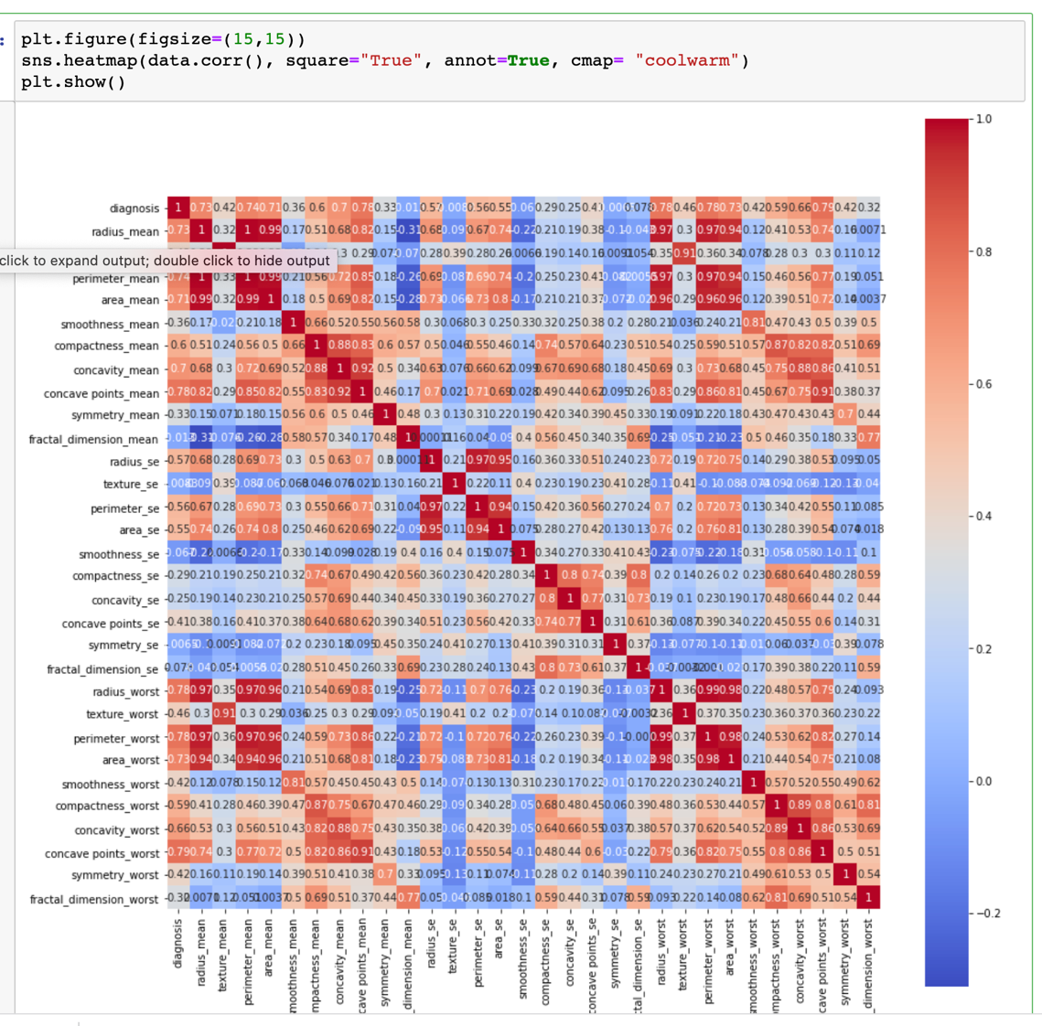
Exploratory Data Analysis
Visualize Data
There are quite a few variables that are correlated. Often, we have features that are highly correlated and those provide redundant information.
By eliminating highly correlated features we can avoid a predictive bias for the information contained in these features.

Slide 5
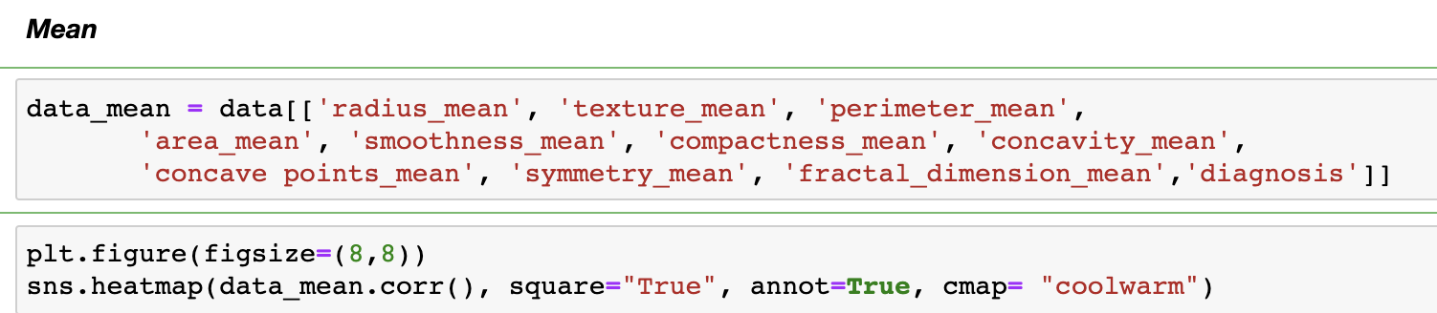
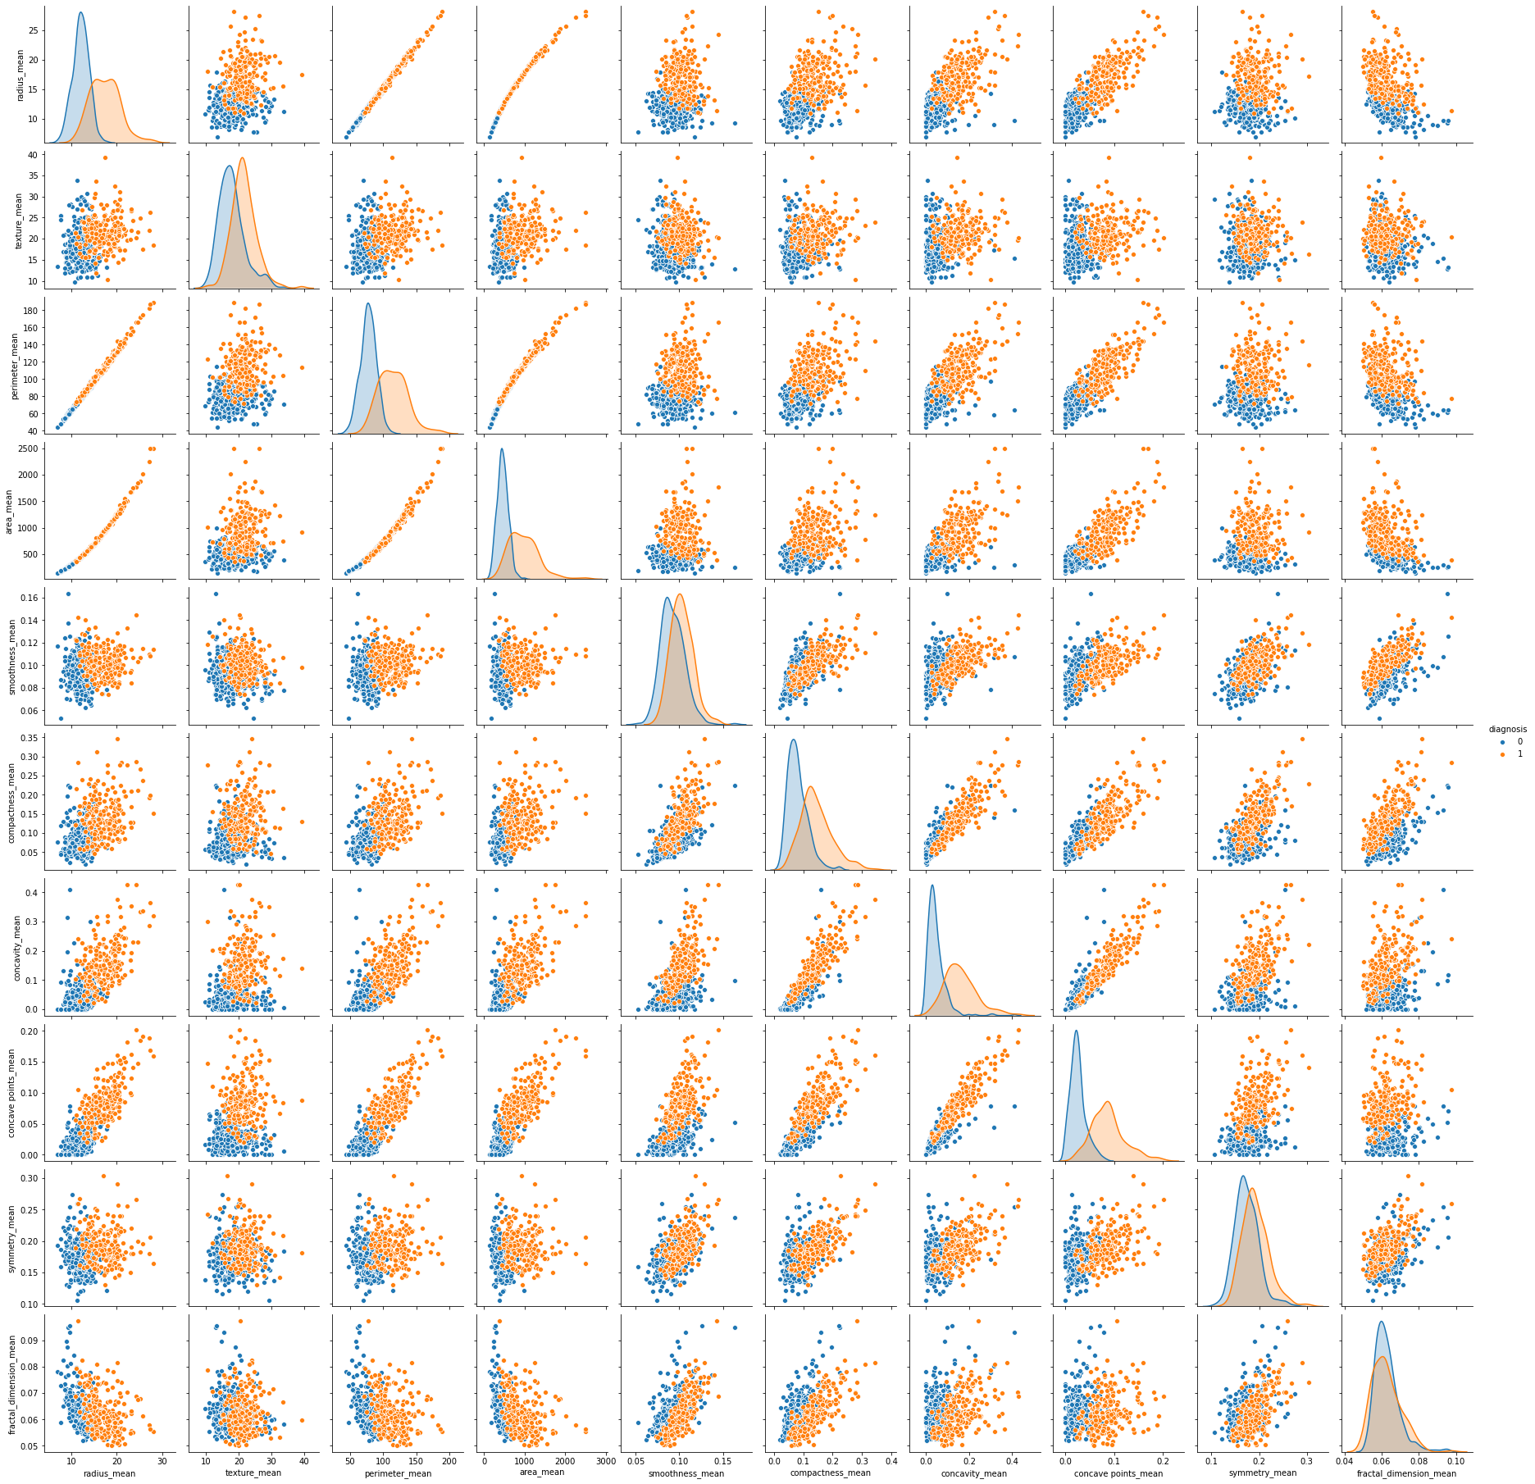
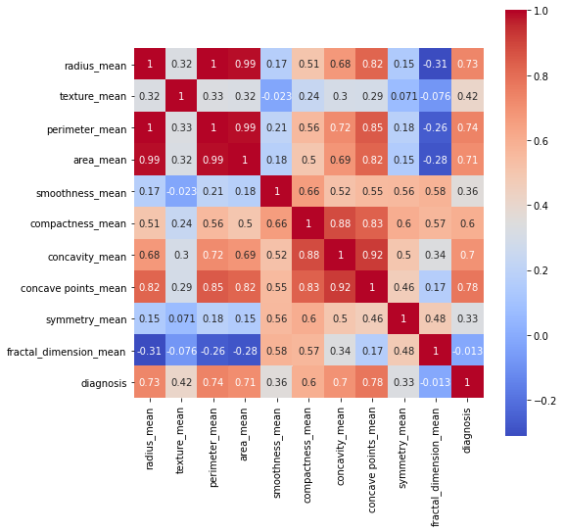
Correlation Between The Pairs of Two Variables
Most of the features are normally distributed.
Comparison of radius distribution by malignancy shows that there is no perfect separation between any of the features; we do have fairly good separations for area_mean, perimeter_mean.

Slide 6
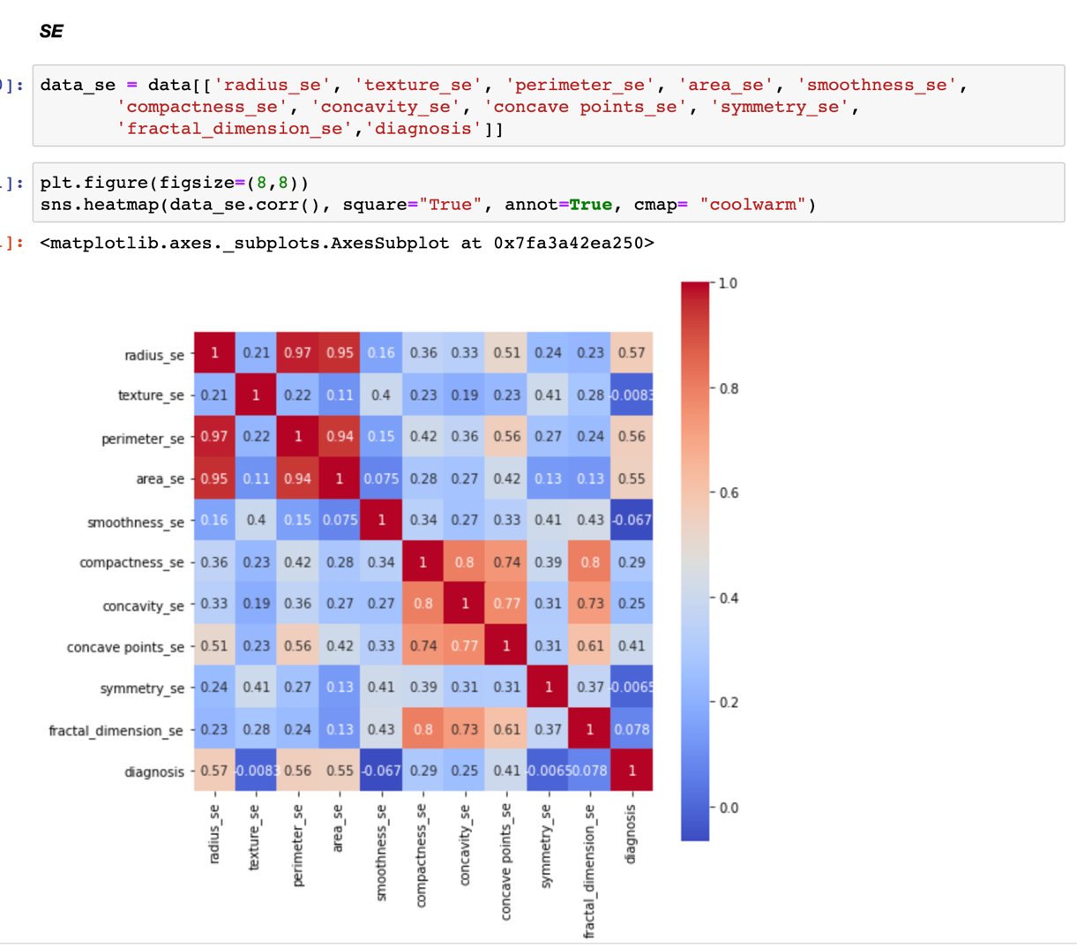
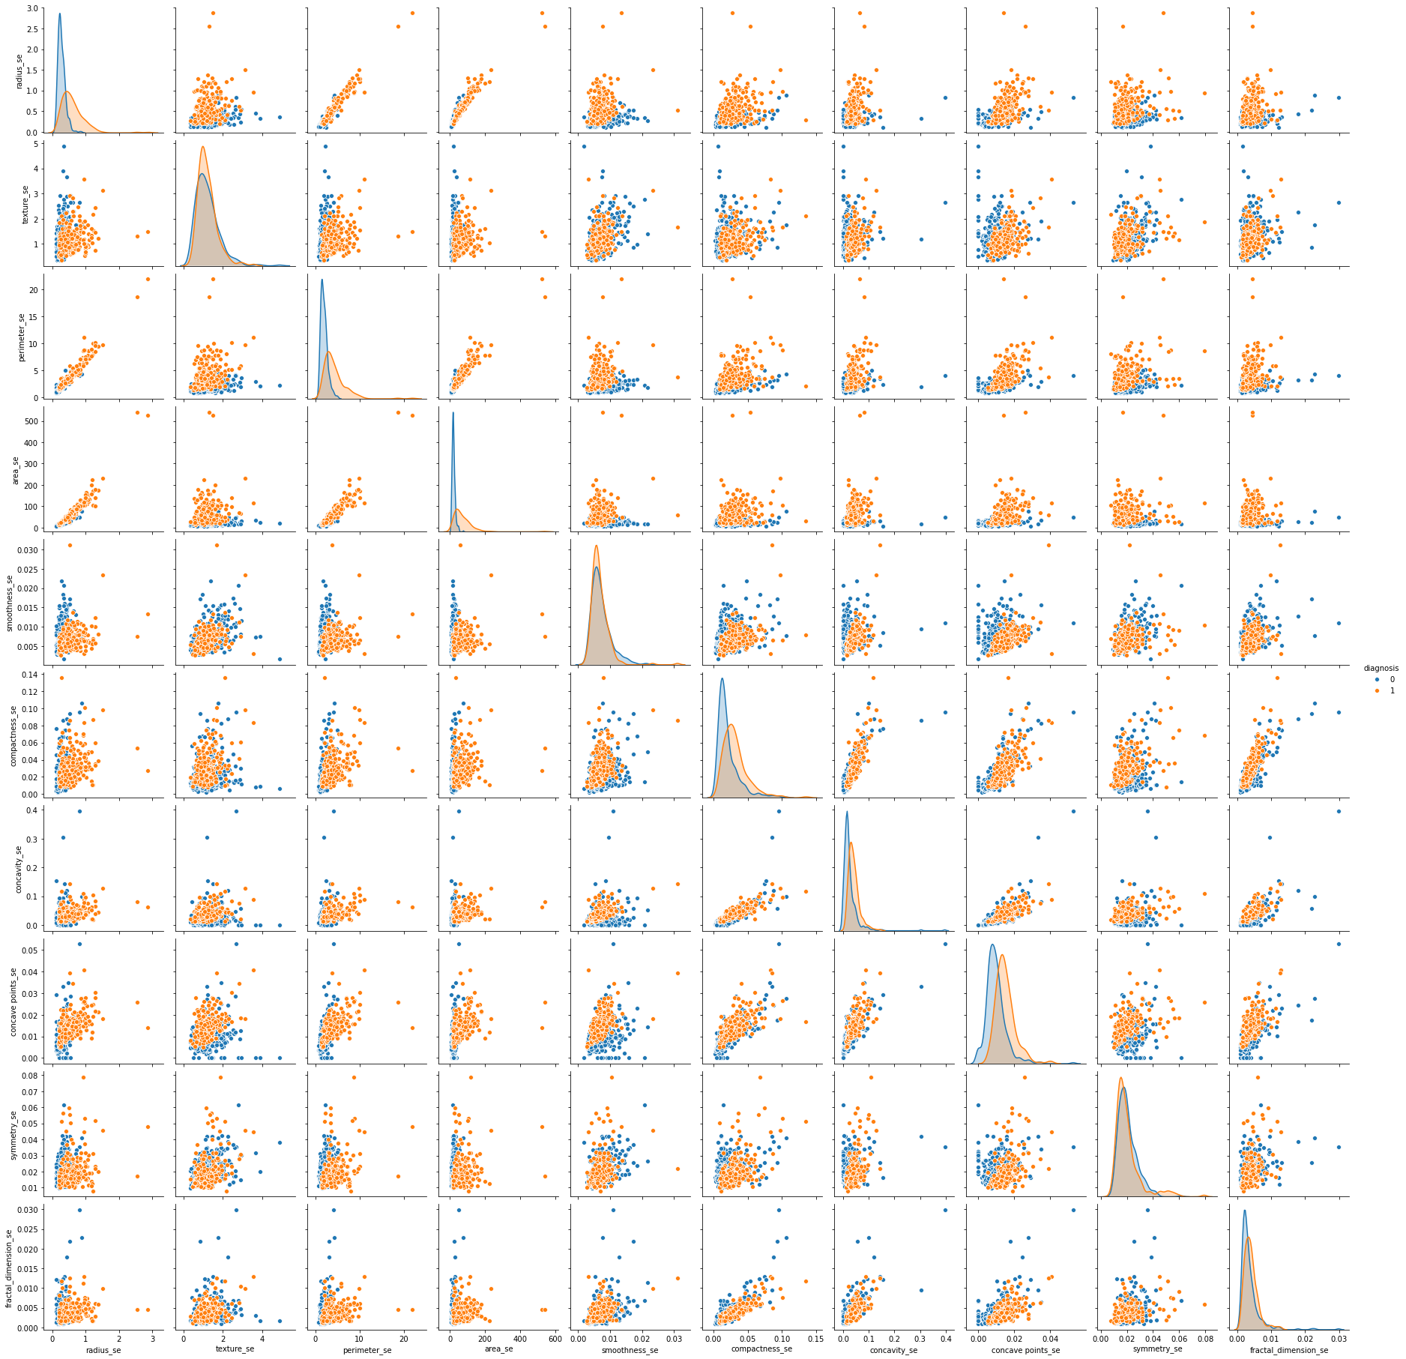
Correlation Between The Pairs of Two Variables
Most of the features are normally
We do have as well tight superposition for some of the values, like symmetry_se, smoothness_se

Slide 7
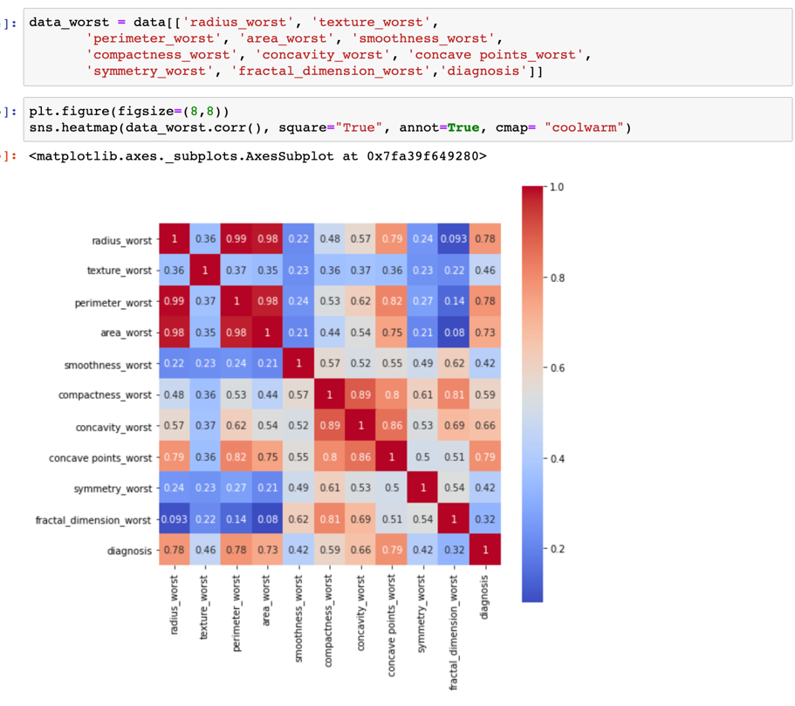
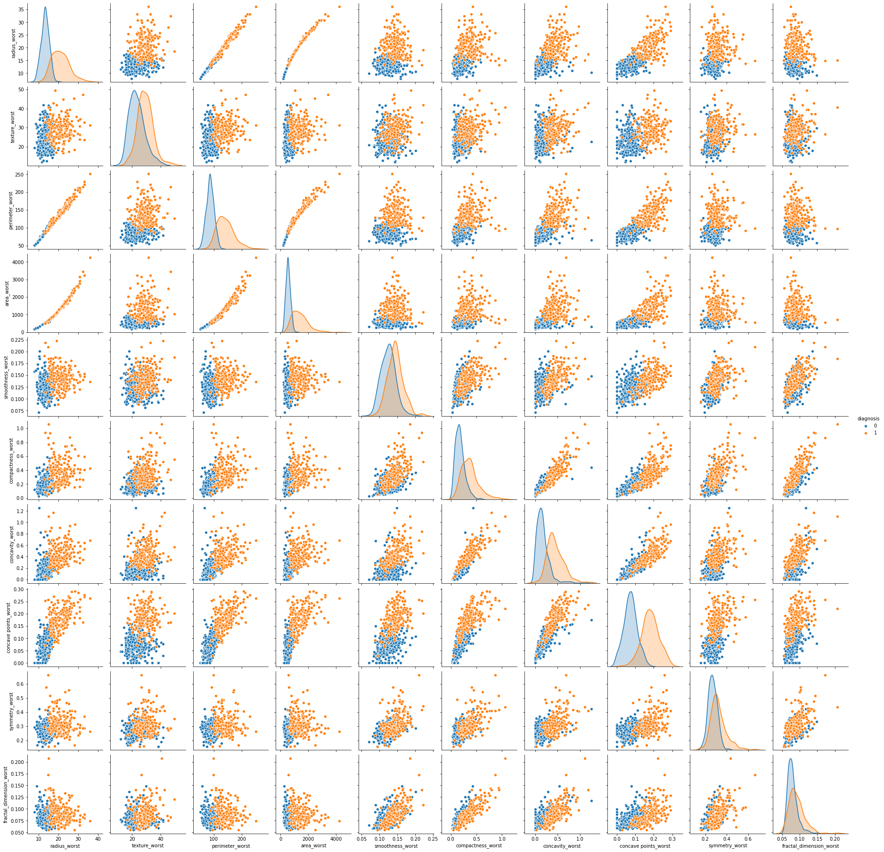
Correlation Between The Pairs of Two Variables
Most of the features are normally distributed.
Comparison of radius distribution by malignancy shows that there is no perfect separation between any of the features; we do have fairly good separations for concave.points_worst, concavity_worst, perimeter_worst

Slide 8
Pre-Processing Model
Apply information value (IV) technique for the selection of important features
Select only features displaying IV statistics within a range of 0.1-0.8
Iv < 0.1: not useful for modeling
IV > 0.8: biased relationship with a dependent variable
Reduce multicollinearity issue using variance inflation factor (VIF) technique
Features exhibiting VIF greater than 5 exhibit extreme multicollinearity and are removed
7 features are retained at the end:
'compactness_se', 'fractal_dimension_se', 'fractal_dimension_worst', 'smoothness_mean', 'smoothness_se', 'symmetry_mean', 'symmetry_se'

Slide 9
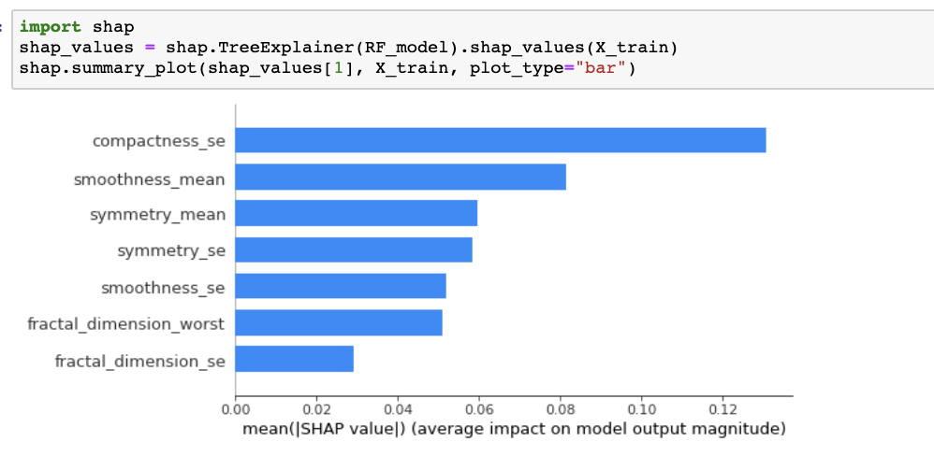
Pre-Processing Model
Plotting the feature importance is one way that you can gain a perspective on which features are driving the model predictions.
The importance of features and their impact on the model’s output can be explained with shap values and their summary plots.
Comparing the shap summary plot, compactness_se and smoothness_mean are the most important features affecting the classification decision or model output.

Slide 10
Data Modeling
Data are partitioned into train and test sets with a size ratio of 7/3
The following models will be built and compared:
Random Forest Classifier
Logistic Regression
Support Vector Machine Classifier
KNeighbors Classifier

Slide 11
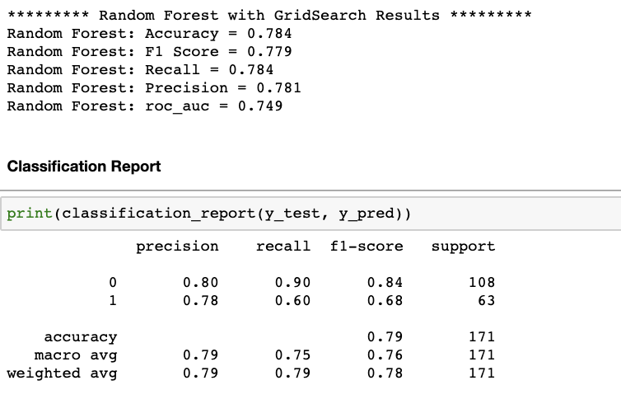
Random Forest Classifier
Grid search is be used to find the best hyperparameters for the model
The best model parameters are selected with accuracy and recall score of 0.784

Slide 12
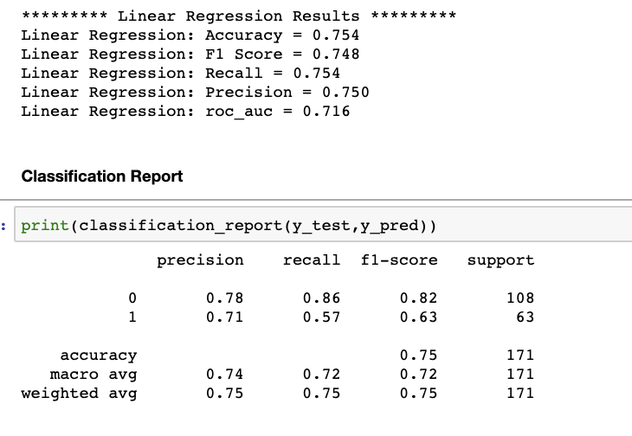
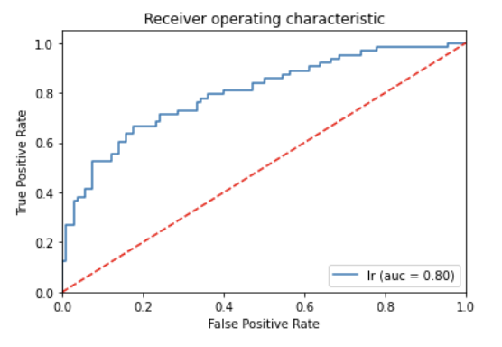
Logistic Regression
The model performs with Accuracy and Recall of 0.754
The model has AUC = 0.8 > 0.5. It is perfectly able to distinguish between classes.

Slide 13
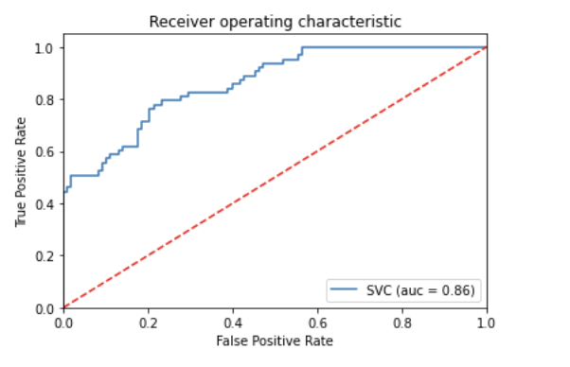
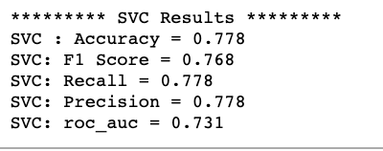
Support Vector Machine Classifier
To improve the performance of the support vector machine we will need to select the best parameters for the model by tuning the hyperparameter
Accuracy = 0.778 and Recall = 0.778
This model has AUC = 0.86 greater than logistic regression model

Slide 14
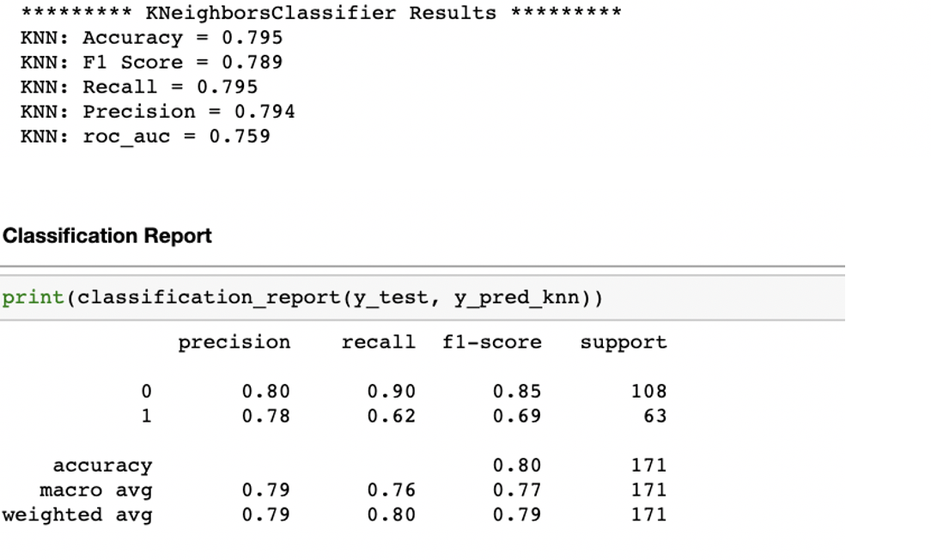
KNeighbors Classifier
Select number of neighbors that result in max score in the testing dataset
Fit and train model again
Accuracy = 0.795 and Recall = 0.795

Slide 15
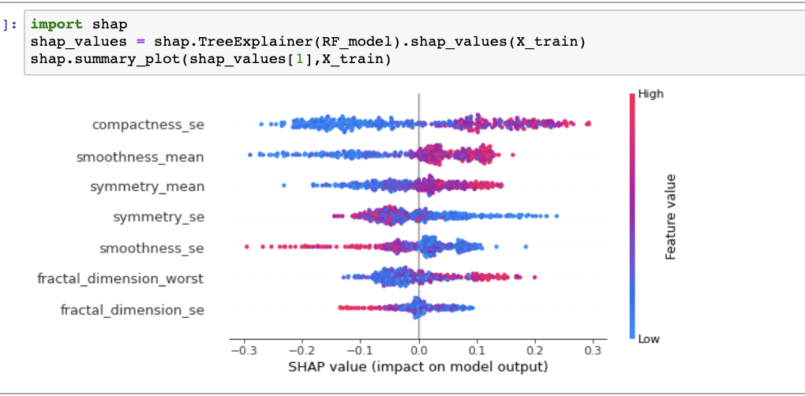
Impact of Features on Breast Cancer Diagnostic

Slide 16
Conclusion
There is more cost associated with the improper classification of the presence of malignant. As a result, the model predicting malignant should be very accurate in properly classifying the presence of malignant. As we compare all the models above, KNeighbors Classifier model perform the best with an accuracy of 80% and especially the recall is 80% highest among the models.
“Compactness_se” and “smoothness_mean” are the most important features affecting the classification decision or model output. The healthcare community can perform additional research corresponding to these attributes to help prevent pervasion of breast cancer.
According to the cancer priority as one of the important health issues in the world that imposes mortality and costs, there is an urgent need for survival prediction strategies. One of the main goals in cancer patients is the estimation of survival. It leads to better management, optimal uses of resources and providing individualized treatment. Using machine learning techniques can help to prevent potential errors in survival estimation, provide appropriate and individualized treatments to patients and improve the prognosis of cancers.

